Slide 1





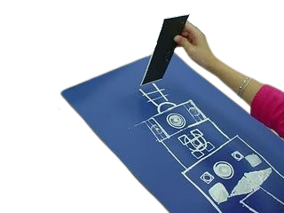

Blueprints!
PRINTING WITH SHAPES TO BUILD COMMUNITY

Slide 2

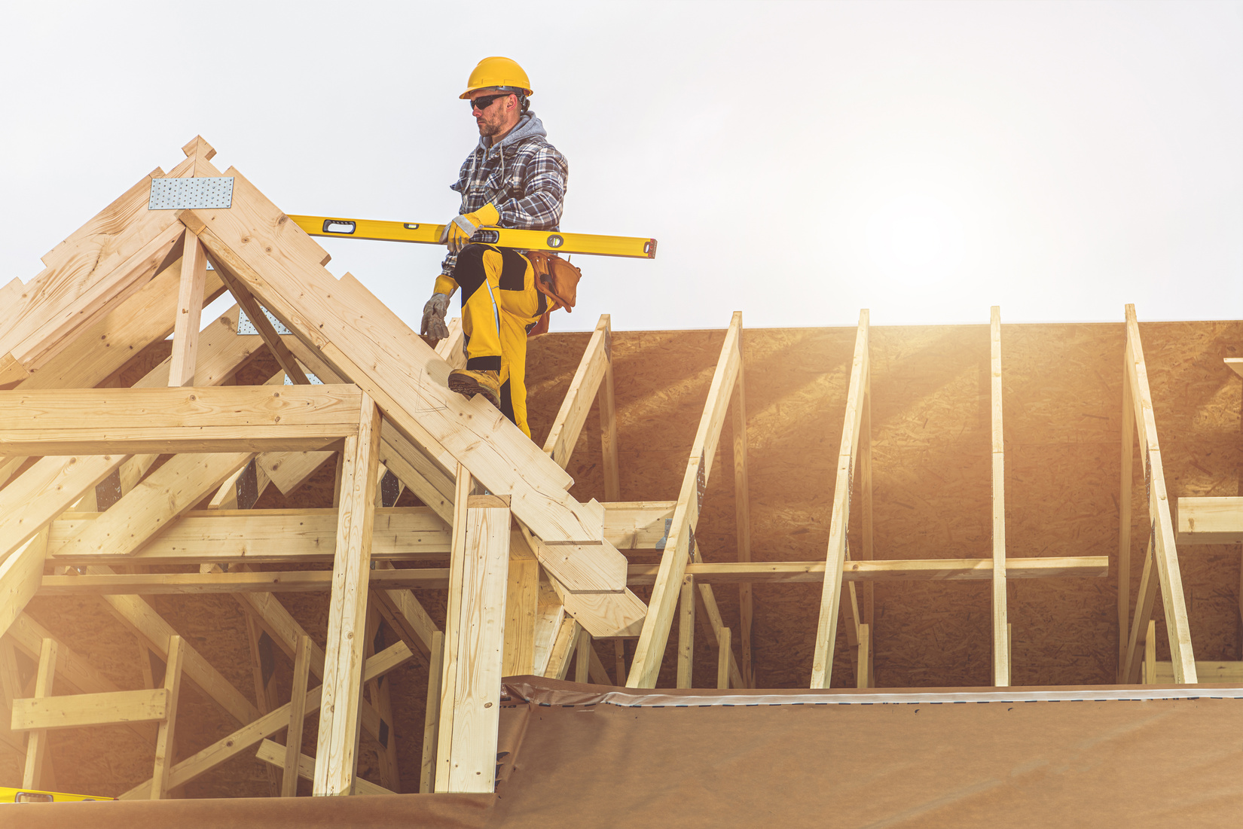
BRILLIANT BLUEPRINTS
OUTLINE OF LESSON
1. Career Connection
2. Shapes and Patterns in Buildings
3. Mark-making with Recycled Materials
4. Reflection
Centre of Excellence for Skilled Trades and Manufacturing

Slide 3
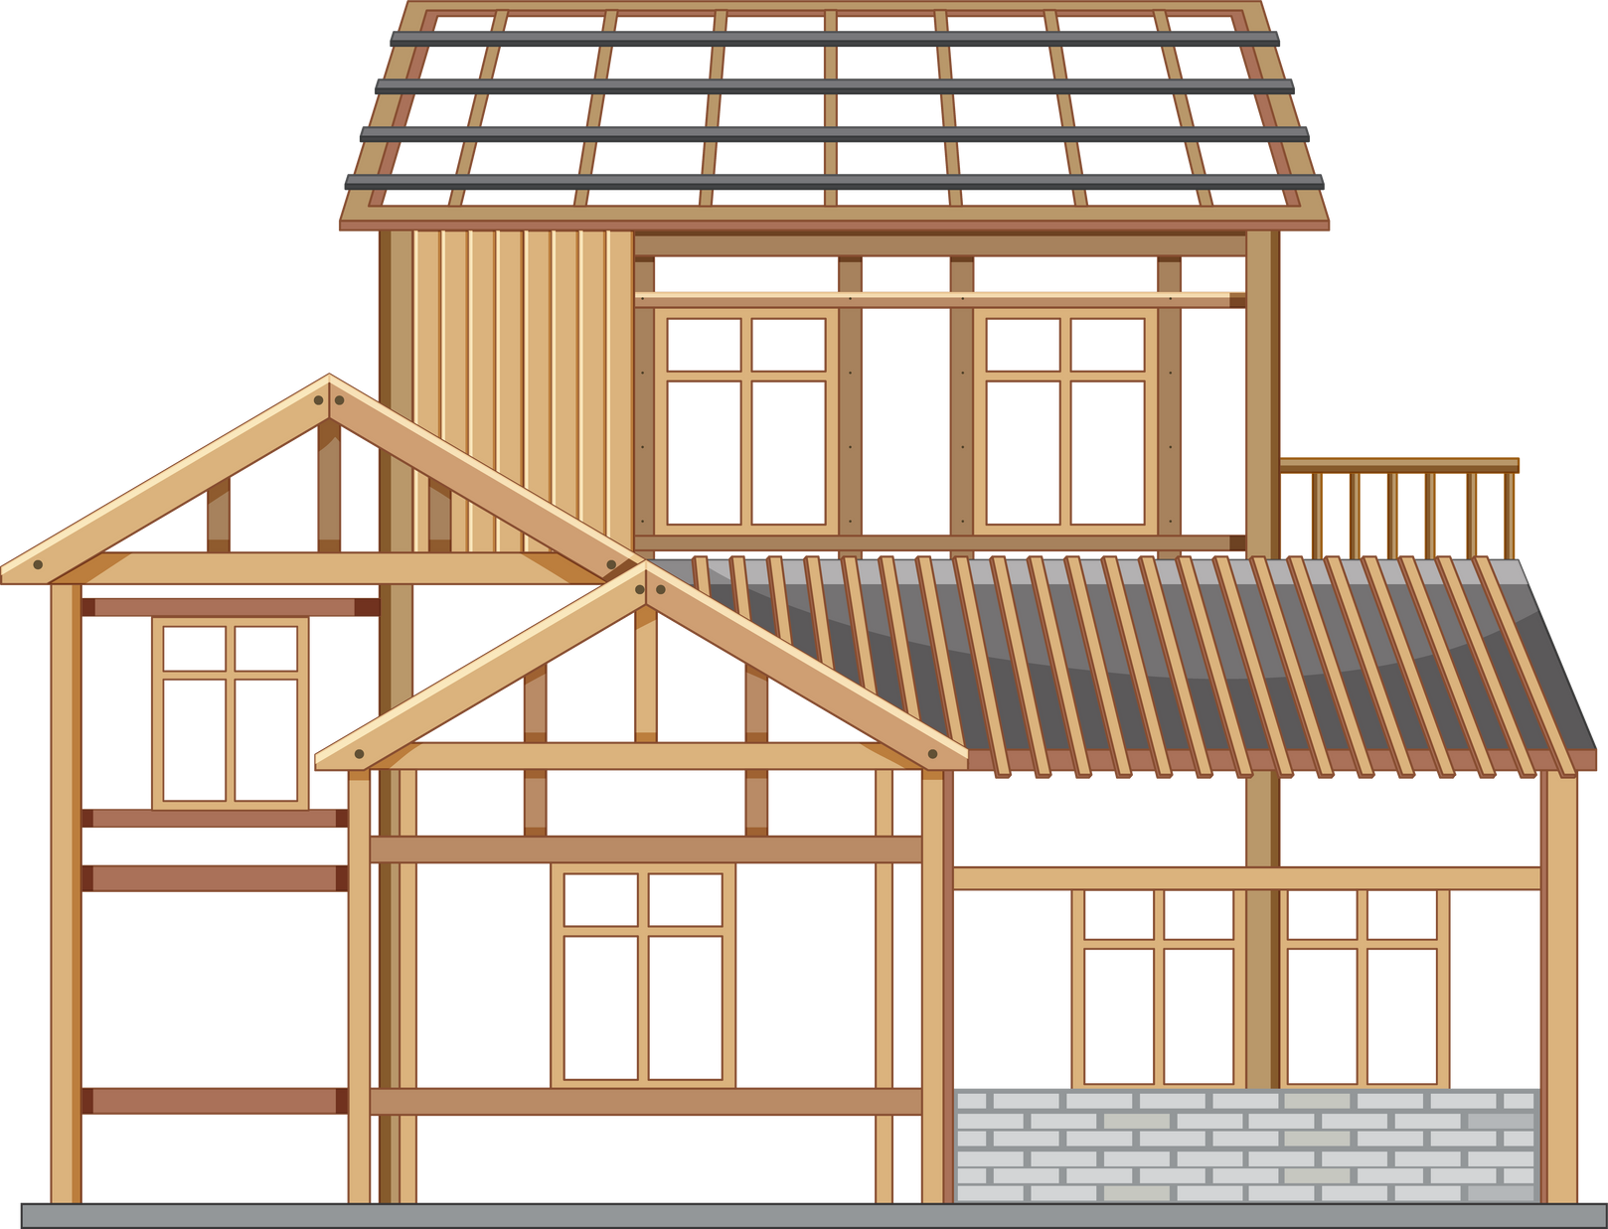
CAREERS
WHO BUILDS HOMES IN NEW BRUNSWICK?

Slide 4
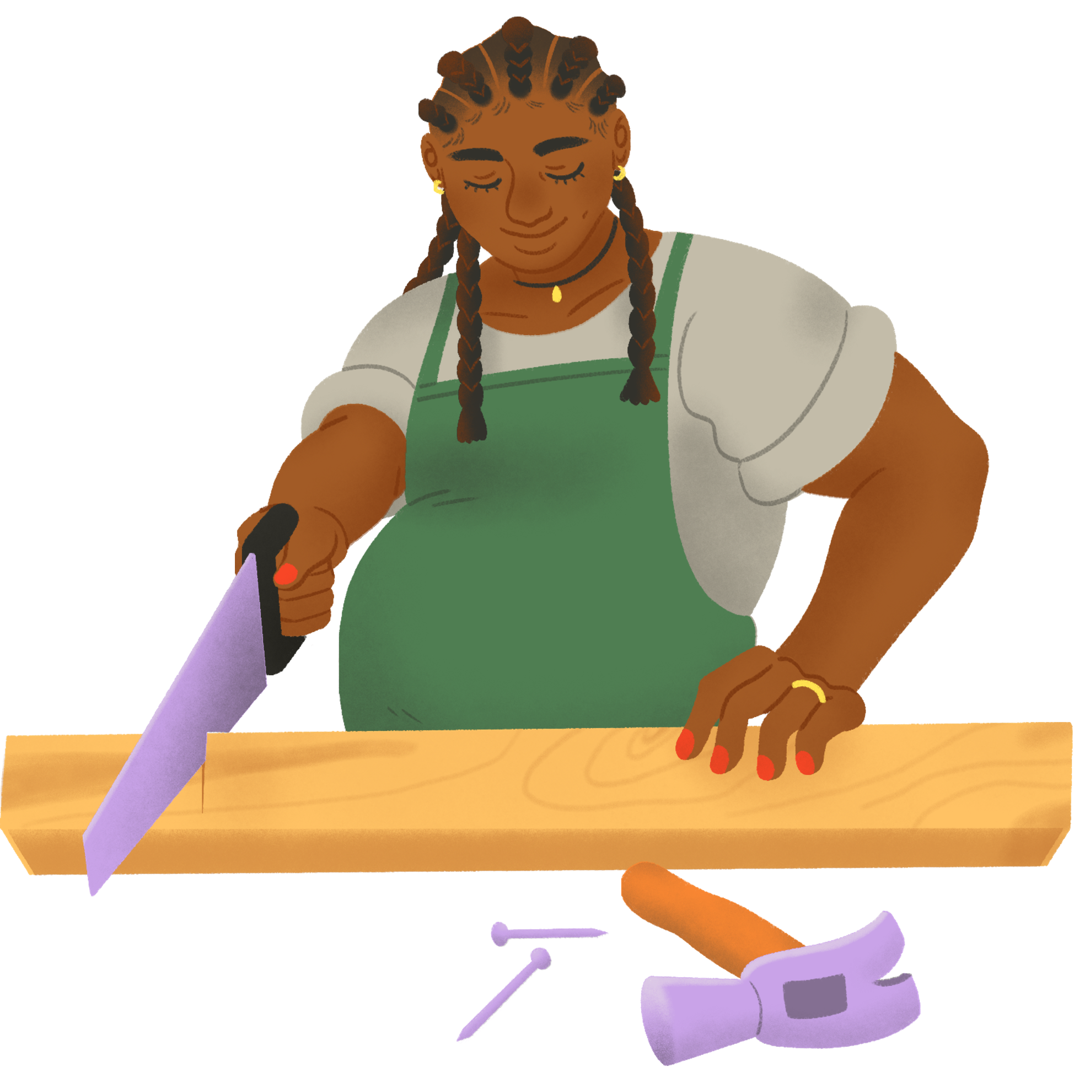
CARPENTER
SAW! SAW! SAW!

Slide 5
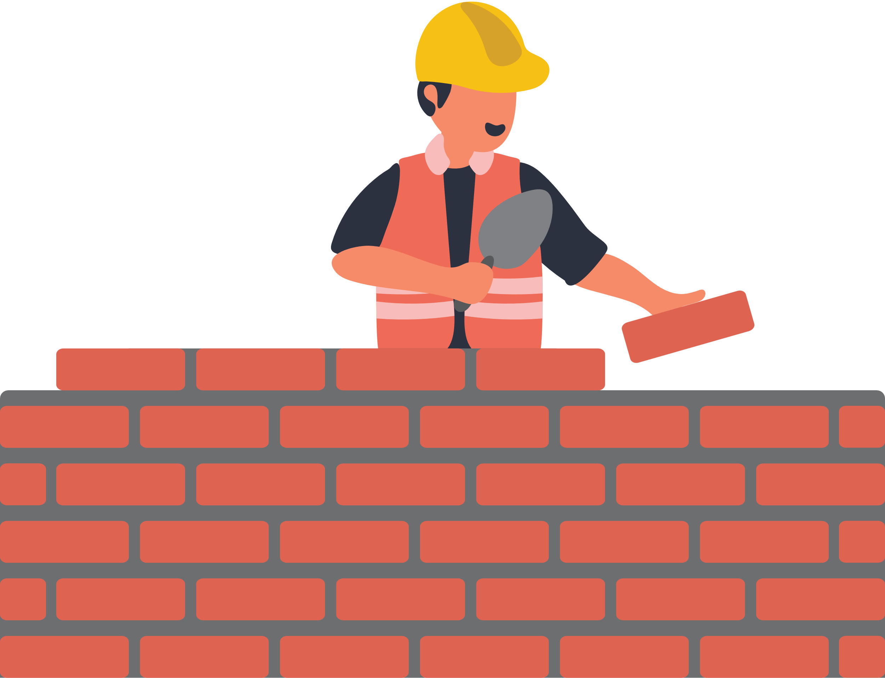
MASON
SPREAD! SPREAD!

Slide 6


PLUMBER
TWIST! TWIST! TWIST!

Slide 7


ELECTRICIAN
CLIC! CLIC! CLIC!

Slide 8
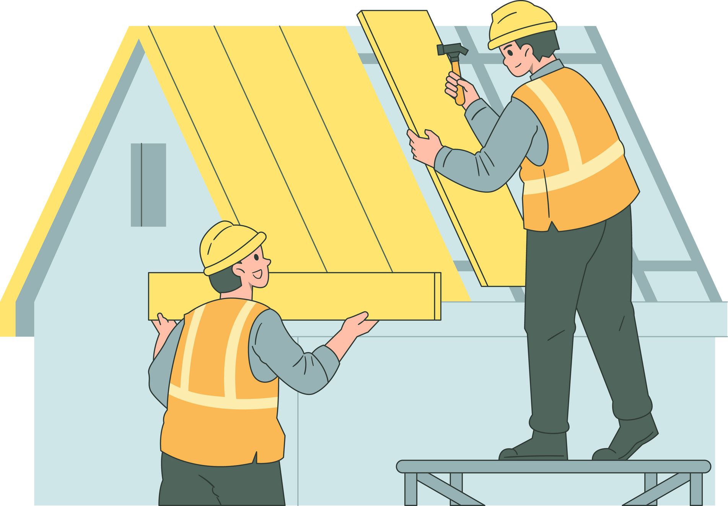

ROOFER
TAP! TAP! TAP!

Slide 9
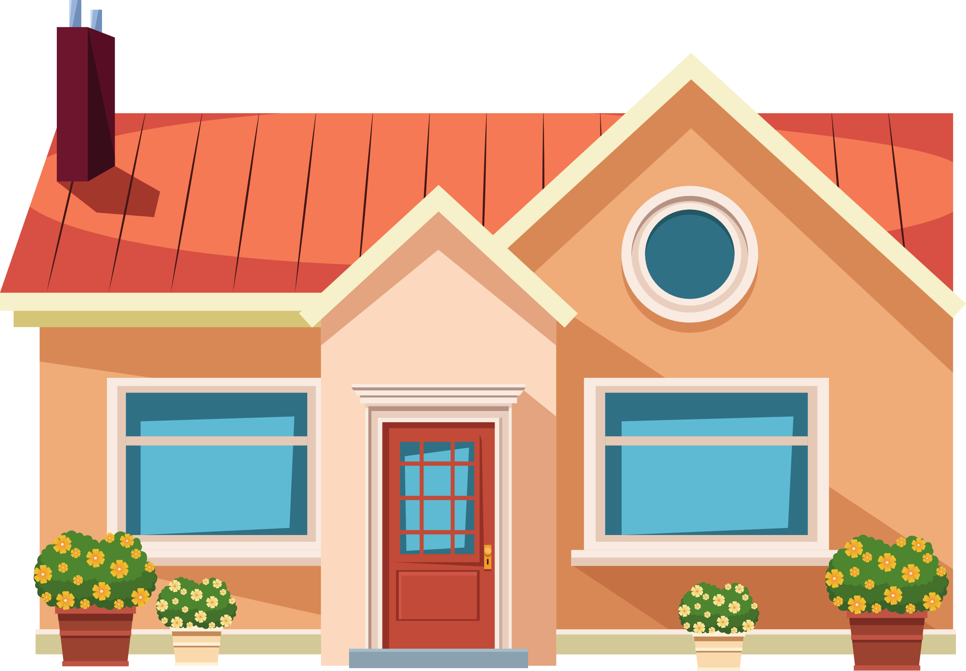

BUILDING A HOME
HOORAY! HOORAY!

Slide 10
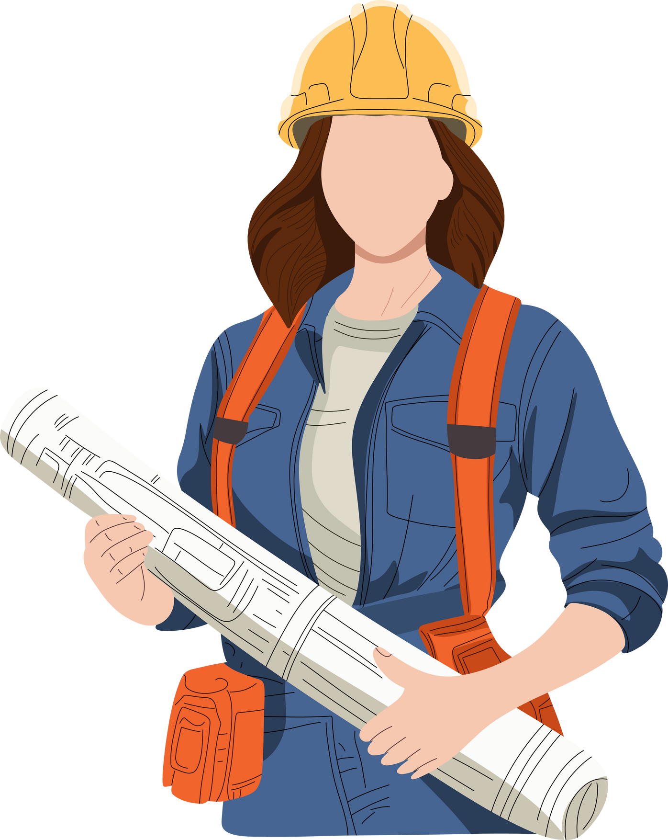
What is a
Blueprint?
Blueprints are detailed drawings that show how to build things, like houses or machines.
They help builders know exactly what to do.

Slide 11
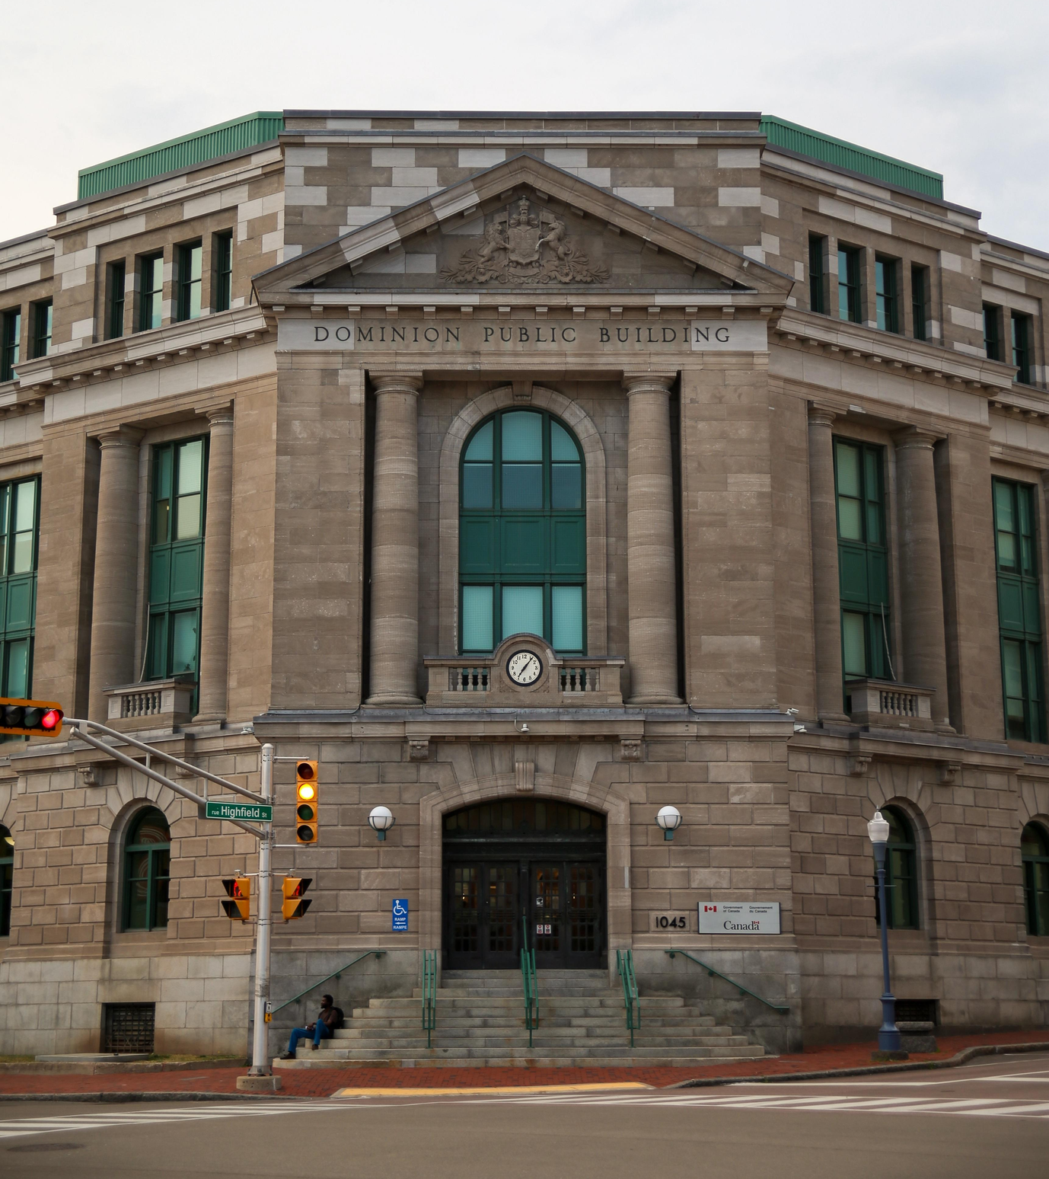
Finding Shapes in Buildings
This building is in downtown Moncton. How many shapes can you find here?

Slide 12
Finding Shapes in Buildings
Squares and Rectangles!

Slide 13
Finding Shapes in Buildings
Triangle!

Slide 14
Finding Shapes in Buildings
Circle!

Slide 15
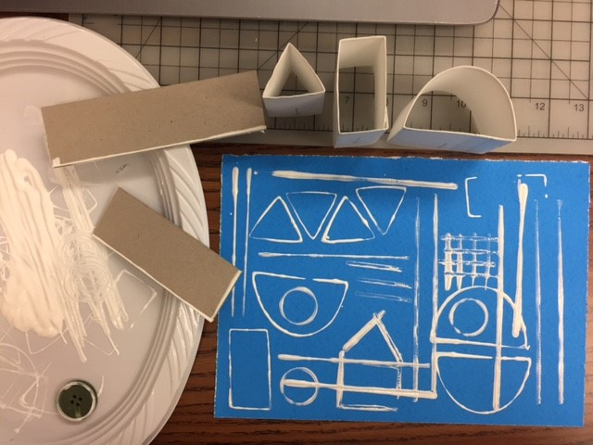



Playing with Mark-Making
Pick a shape!
Dip in paint!
Press on paper!

Slide 16
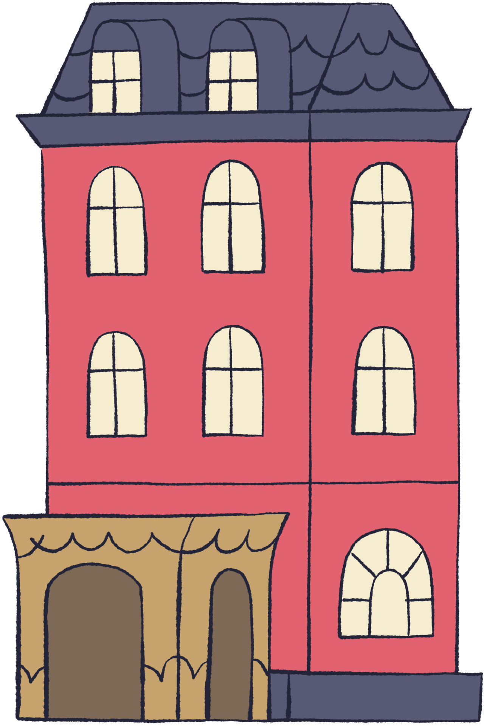

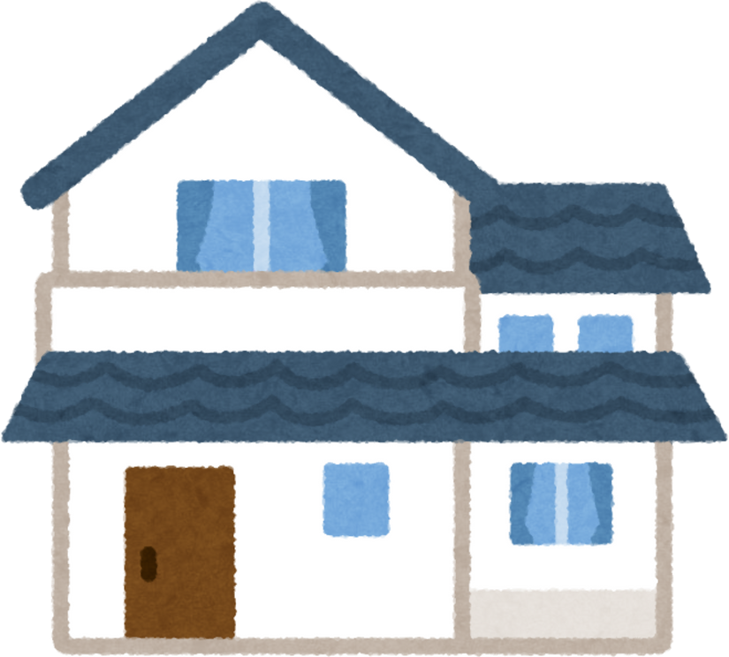
Brainstorm - Types of Buildings in Our Community

Slide 17
Brainstorm - What Do We Include in a Building Design?
1
What basic parts should all buildings have (walls, door)?

Slide 18
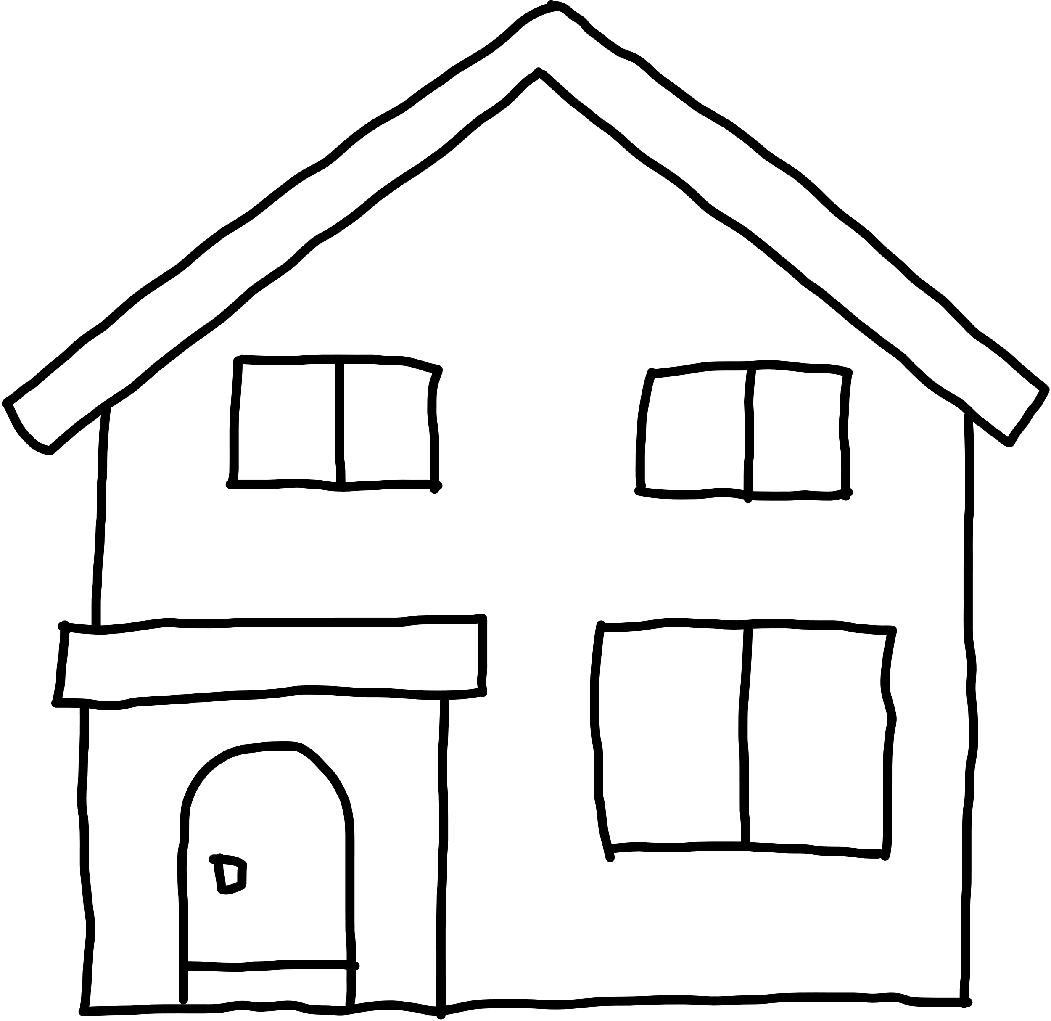
Brainstorm - What Do We Include in a Building Design?
1
Walls
Floors
Windows
Door
Roof
What basic parts should all buildings have (walls, door)?

Slide 19
Brainstorm - What Details Can We Include?
2
What details can we add to show the type of building you are designing? (home, fire station, store, art gallery)

Slide 20



Brainstorm - What Details Can We Include?
Chimney
Garage
Balcony

Slide 21
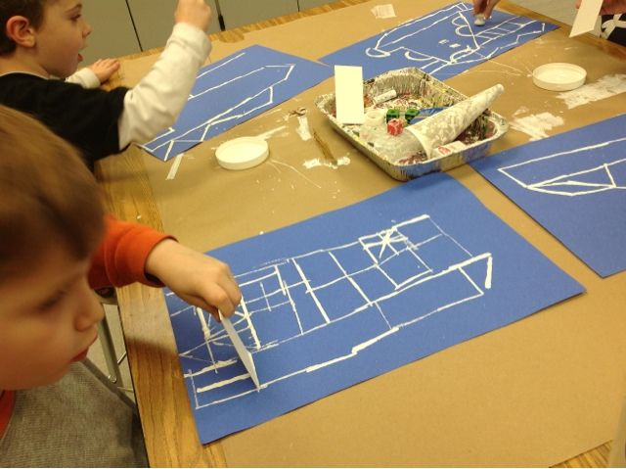
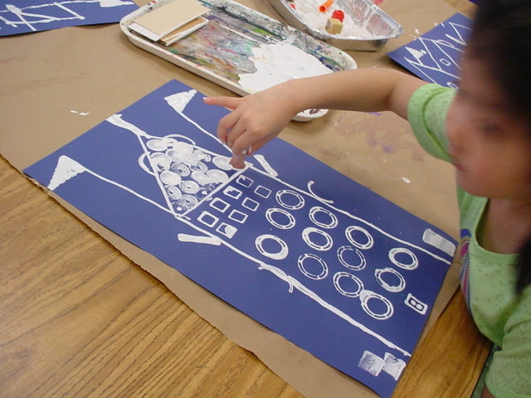
Time to Design!
Turn your ideas into a design! Think about the kinds of marks that will work best to create each part of the building.

Slide 22
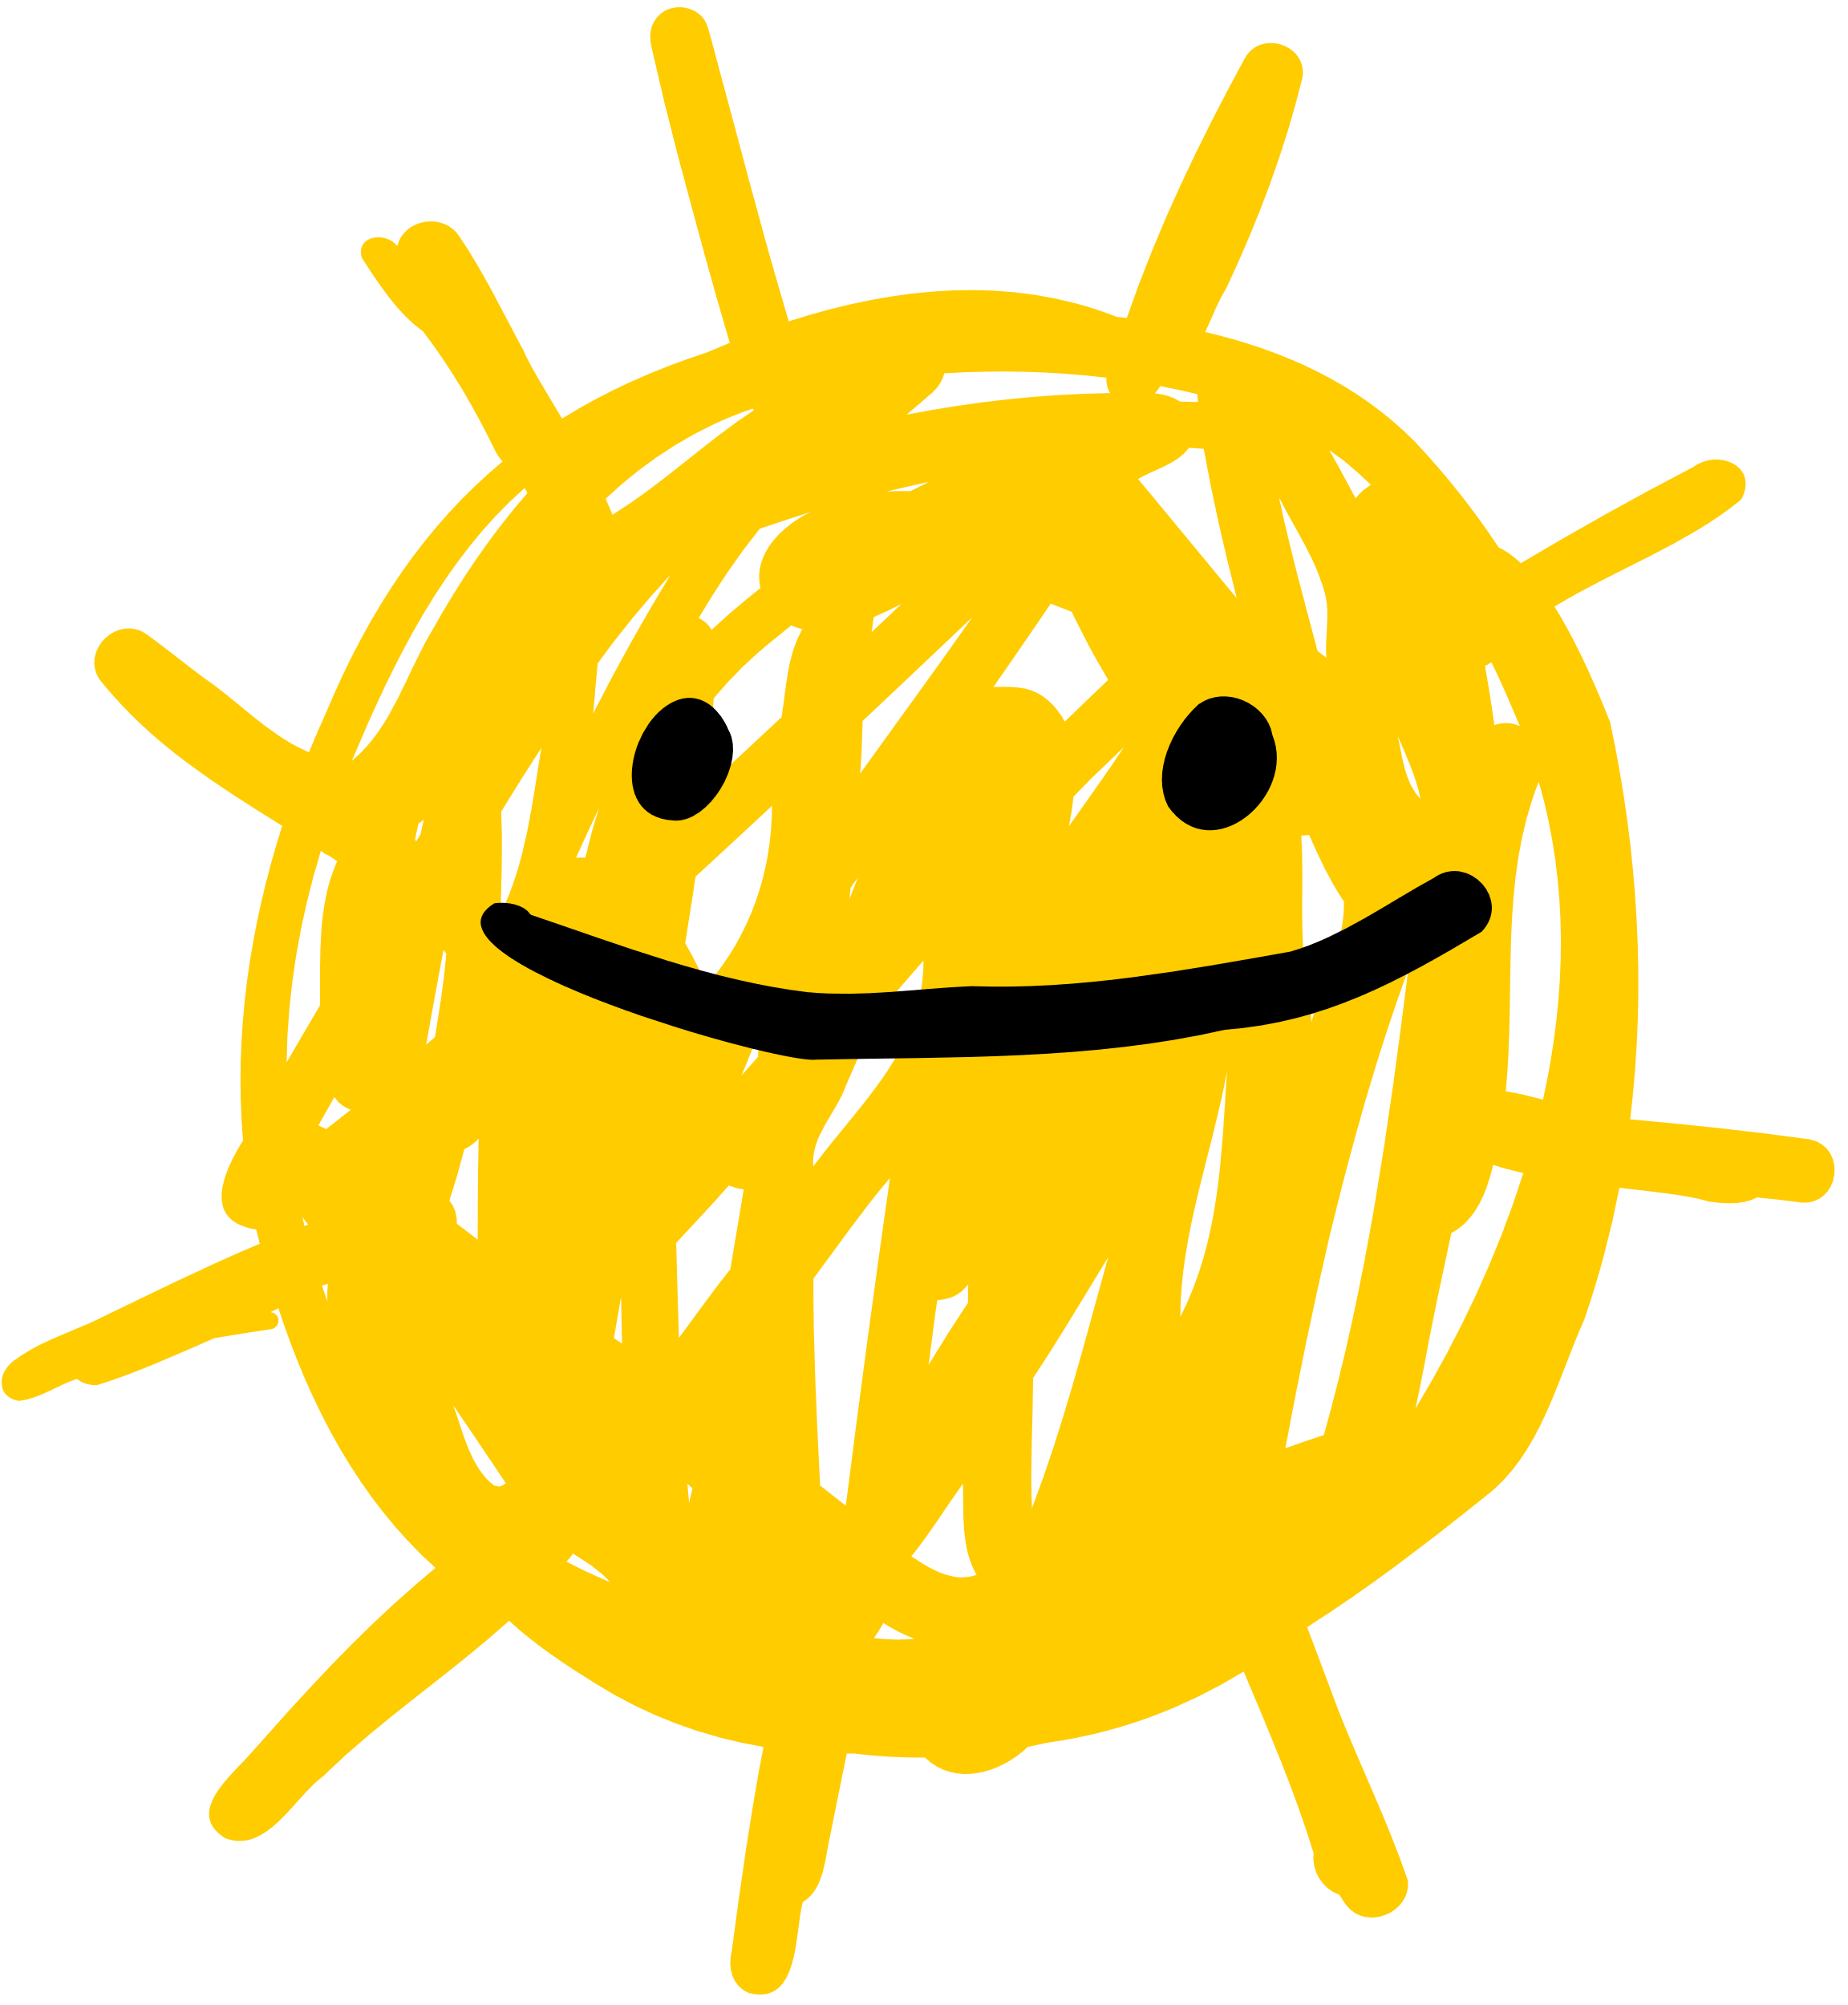
Reflection Questions
What did I do today?
What part of the activity was my favorite?
Turn to your neighbor and explain today’s activity, pretending that they were absent and missed the lesson. Describe your favorite part of the activity in detail.

Slide 23

Reflection Questions
What is something that challenged me?
Think about one thing that challenged you in doing today’s activity. How did you work through this challenge? What might you do the same or differently next time?

Slide 24

Reflection Questions
What did I learn about myself today?
Examples:
I love sharing ideas with friends!
I like trying new things.
I’m interested in learning more about buildings in my community!
I can solve problems when I am patient!

