Slide 1

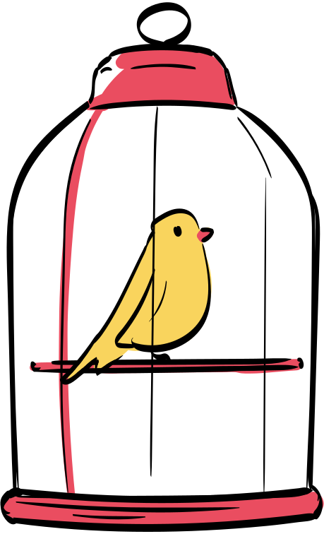






Build a
Pet House
Design, Measure, Construct!

Slide 2

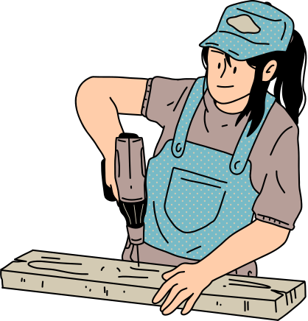
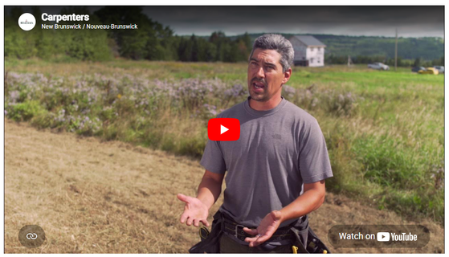
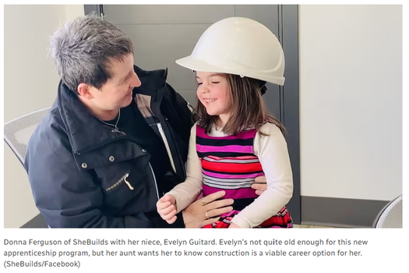
Career Connection
Carpentry Skills
Carpentry in N.B.
Gender Equity
Watch the video and record 3 key take aways using the sentence starters provided.
Brainstorm a list of carpentry skills and share with the group.
Read the article and discuss (discussion questions provided).

Slide 3
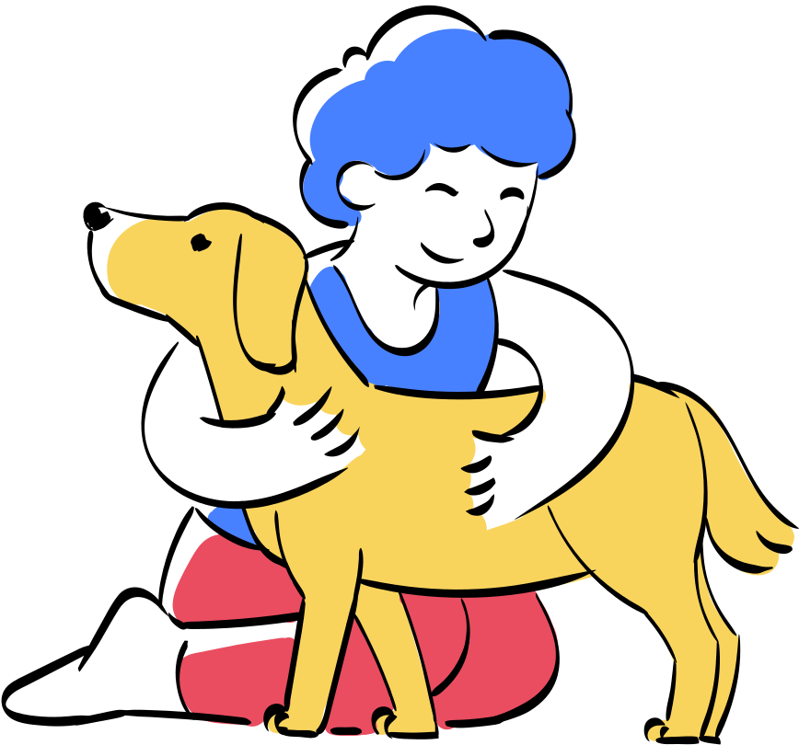


Client Scenarios
Example
A family lives in a rural area and has a large dog named Bear who spends most of the time outdoors. Winters are very cold, with lots of snow and wind. Bear needs a shelter that will keep them warm, dry, and protected from harsh weather. The family wants something strong and sturdy that can handle winter conditions, but also easy to clean. They care about Bear’s comfort and want them to feel safe and cozy.
The Client
The User
The Problem
The best designs solve real problems, for real people - and pets!

Slide 4


Planning and Measurement
Perimeter
Calculate the perimeter. Why does perimeter matter?
Floor area
What should we consider when calculating the area?
Volume
How much volume will be required for comfort and safety?
Extend your learning...
Angles
What angles are used in your structure (acute, right, obtuse)?

Slide 5

Design Justification
Topic
Examples
Example
Our user is a large outdoor dog named Bear who requires a warm, dry, and safe place to rest during cold winter weather.
The client is a family living in a rural area who needs a strong and sturdy dog shelter that can handle snow, wind, and freezing temperatures, while also being easy to clean.
I have used mathematics in this design by measuring the size of the shelter so Bear has enough space to stand, turn, and lie down comfortably. I also used math to plan the shape and sloped roof so snow can slide off, and to make sure the walls are thick enough to help keep heat inside.
Protection from weather
Exercise area
Room for water dish
User Needs
Affordable
Weather proof
Not to large (small space)
Client Needs
Dimensions
Shapes
Angles
Measurment

Slide 6
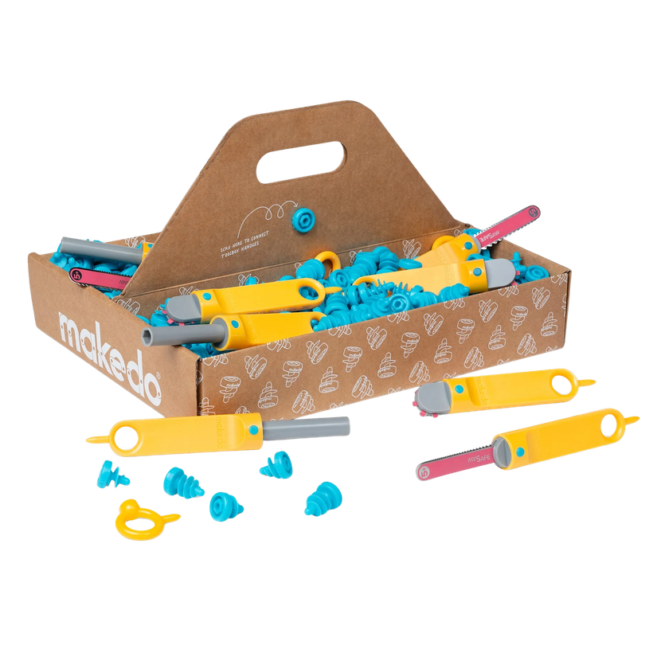
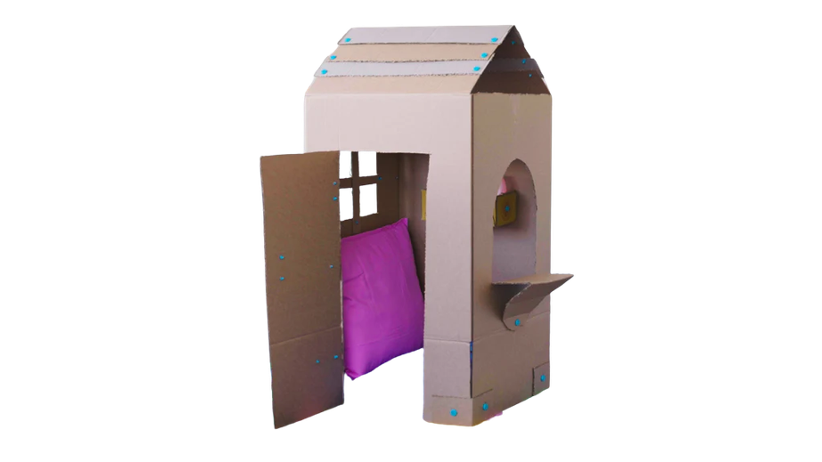
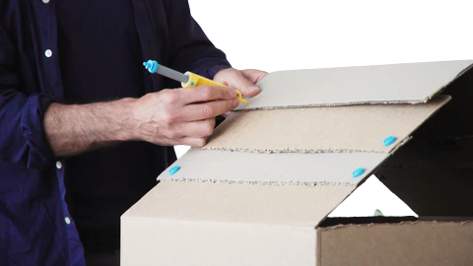
Time to Build
Learn
Explore
Build
How are these tools similar to or different from the everyday tools used by carpenters.
Following your plan carefully, build your pet house. Record and changes and justification.
Watch the instructional videos on the Makedo Website -
*** If using alternate materials (tape, scissors, etc.) discuss the explore and build components only

Slide 7

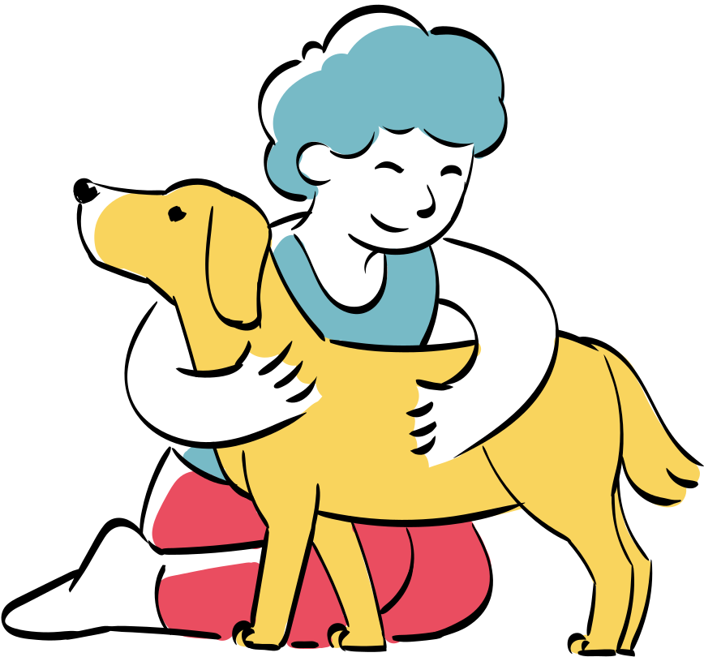

Success Criteria
Pair and Share Brainstorm
1. How did understanding the pet change your design?
2. What math concept was most useful?
3. What would you improve in a real build?
4. What did you find most challenging?
5. What did you enjoy about this project?

Slide 8




Extension Ideas
Explore the outdoor/natural world to examine how animals in nature build their own habitats to live in.
Write a short story about the intended user (pet) and client (owner) that features design elements from your pet house.
What are some addition features to add to your pet house to make it energy efficient and comfortable for your pet?
Create a marketing campaign for the pet house design (television, print, social media, etc.).

Slide 9


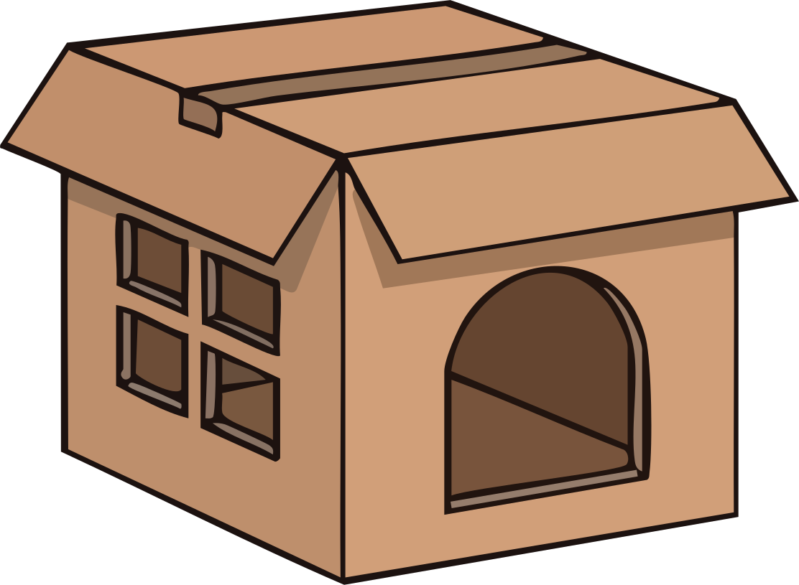
Make Meaning
Reflect
What exactly did I do today? What did I learn?
What challenged me, and how did I respond?
What did I notice about myself or others? Did anything surprise me while completing this project?
Think
How does what I learned connect to something I have already experienced?
What new idea or possibilities did this activity make me think about?
What about the carpentry profession might I enjoy or excel at?

