Slide 1
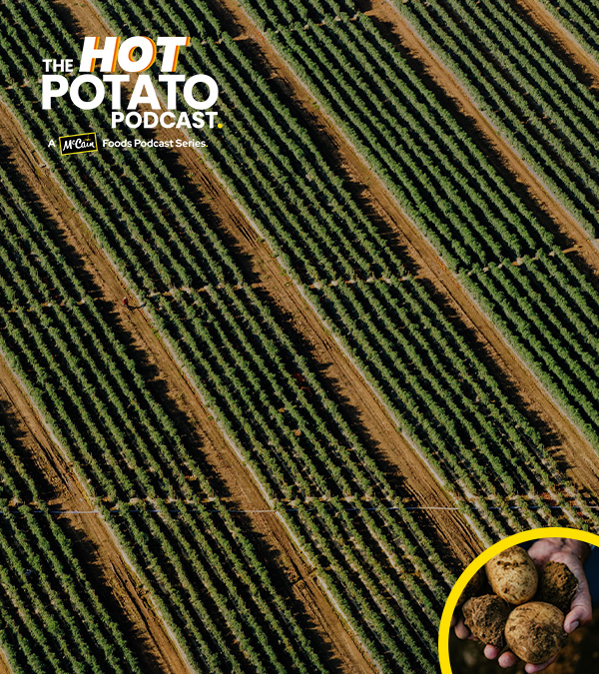



MCCAIN
PITCH FOR PROGRESS

Slide 2

THINK / PAIR / SHARE
Exploring Product Development
What new snacks or foods do you enjoy?
How do you think food products changed over the past fifty years?
Why do you think companies keep inventing new foods? What are they trying to achieve?

Slide 3


Product Development with Jean-Michel Belanger

Slide 4

Post-Video Discussion Questions
How does McCain develop new products from the initial idea to when they’re on the shelf?
What challenges does the food industry face in meeting consumer demands?
What role do innovation and technology play in food production?
Lastly, what do you imagine food production will look like in the future?

Slide 5


THINK / PAIR / SHARE
Exploring Technology Innovation
What kinds of technology or innovations can be used to grow or manufacture food?
How might science and technology be helping create new farming methods or food products?

Slide 6

Current Technologies and Innovations with Rob Braddock

Slide 7

Post-Video Discussion Questions
What farming technologies and innovative manufacturing processes does McCain use today?
How does McCain develop and implement new technologies and innovations?
Can you identify examples of McCain’s latest technologies and innovations, and what impact they have had on food production?

Slide 8

THINK / PAIR / SHARE
Exploring Sustainability Solutions
What farming practices help protect the environment?
How might climate change affect the way farmers grow food?
Why is sustainability important for food companies and farmers?

Slide 9

Sustainable Farming Practices with Kayla Cormier

Slide 10
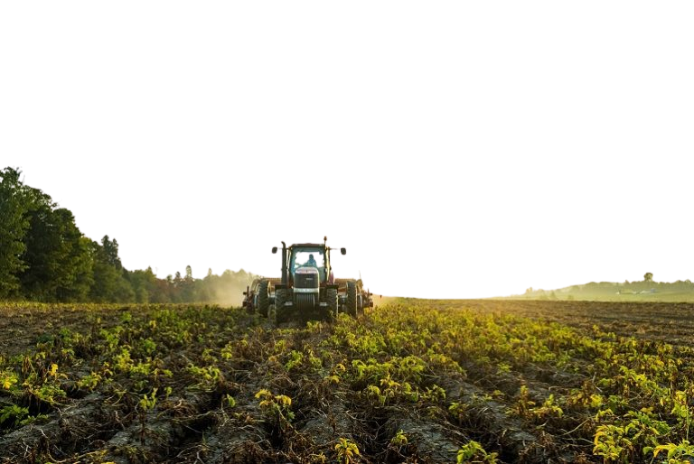
Post-Video Discussion Questions
What sustainable farming practices does McCain use?
How does climate change create challenges for sustainable farming?
Can you think of examples of sustainable practices at McCain, and how they impact food production?

Slide 11


Challenges/Needs
Create three sections on separate chart paper with the following headings:
Product Development
Technology Innovation
Sustainability Solutions
Write down challenges or industry needs and place them in the appropriate category.

Slide 12
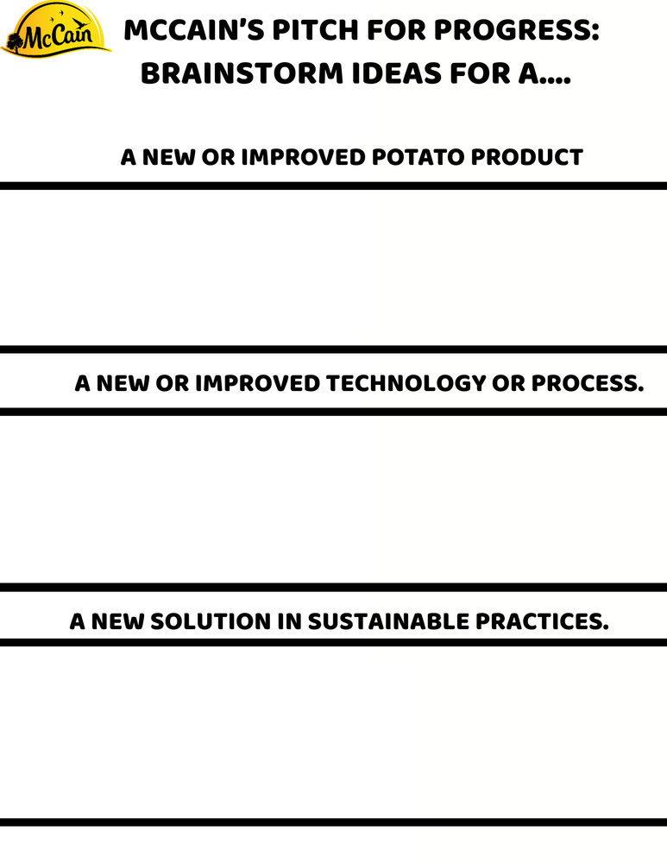
Brainstorm SOLUTIONS
Record all potential ideas on your brainstorming graphic organizer or in a format that works best for you.
Learners may complete this individually or in small groups.
How does this solution address the problem?
Why do you think it could work?

Slide 13

PLAN THE PITCH
Review solutions and ideas
Which challenge feels most meaningful or interesting?
Which solution has the strongest potential for impact?
Which idea could realistically be implemented?
Consider :

Slide 14

CHOOSE ONE PATHWAY
Product Development
Technology Innovation
Sustainability Solution
Learners may work in partners

Slide 15
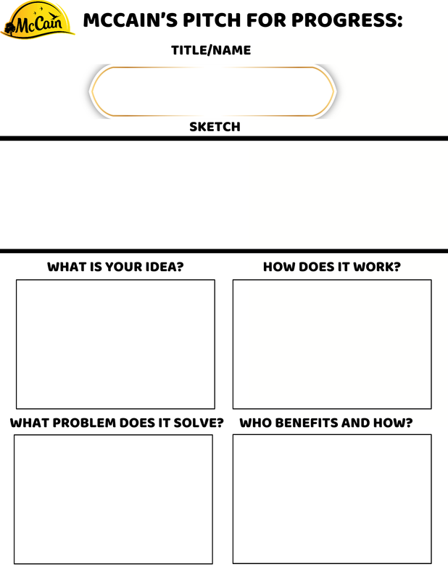
PLAN THE PITCH
Use the McCain’s Pitch for Progress Graphic Organizer
Title/Name
Create a professional, meaningful, and memorable name.
Sketch
Learners sketch their idea.
What Problem Does It Solve?
Clearly define the specific challenge. Who is affected and why does it matter?
What Is Your Idea?
Describe the solution in detail. Include key features, materials, or steps. Explain why the idea is effective and how it directly addresses the problem.
Who Benefits and How?
Identify at least three stakeholders: farmers, consumers, the company, local communities, or the environment. Explain the positive impact for each group.
How Does It Work?
Step-by-step explanation of the process or function. Include diagrams, flowcharts, or sketches to support the explanation.

Slide 16


CREATE YOUR PITCH
Prepare a two minute pitch explaining the problem, your solution, and the impact of your idea.
Suggestions for Pitches
Poster boards or Bristol boards
Canva, PowerPoint, Google Slides, or Prezi.
Produce a short video to explain your solution creatively.
Prototypes or models – Build a physical or digital model to demonstrate your idea in action. This can also be created to support the pitches above.

Slide 17
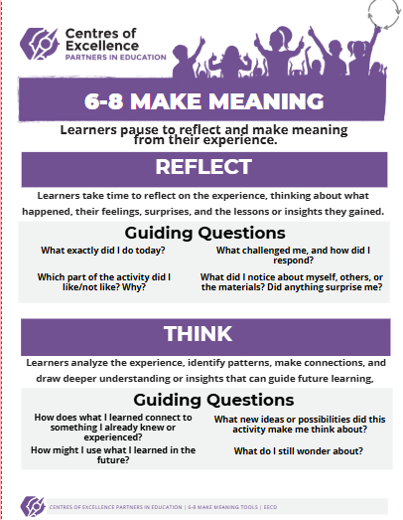

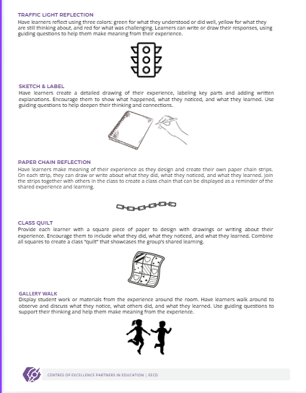
MAKE MEANING
Please see the attached Make Meaning document in lesson plan for several choices on how your learners can reflect upon today’s activity. This is an important step in the experiential learning cycle.

Slide 18
EXTENSION ACTIVITY
Prototype Enhancement
Refine or expand your prototype with additional features or improved functionality. Test your idea in a small experiment or simulation to see how it performs.
Market Research
Conduct a mini-survey to gather opinions on your product, technology, or sustainability solution. Analyze data to see how your idea could meet real consumer needs.
Community Connection
Present ideas to local farmers, sustainability groups, or community organizations. Explore how real-world professionals tackle similar challenges.

