Slide 1
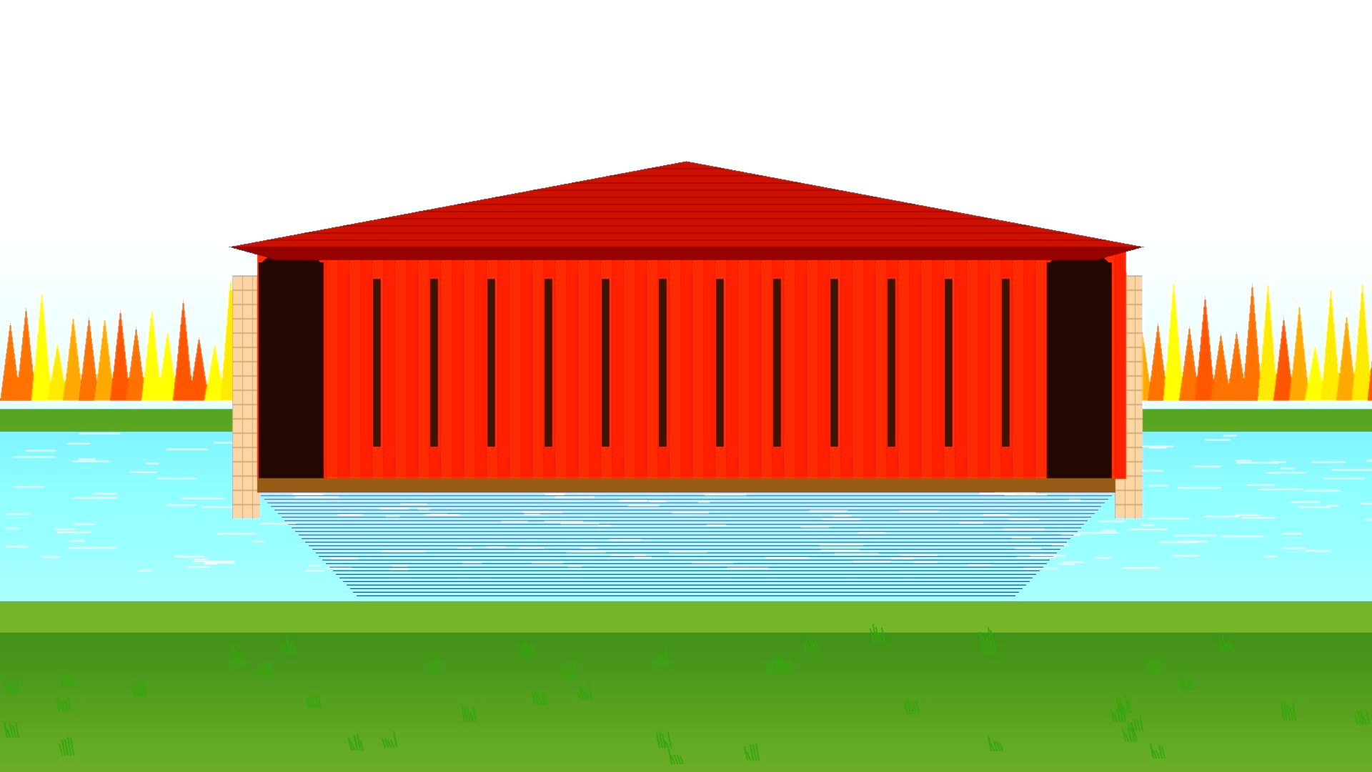
COVERED CONNECTIONS
A HISTORICAL EXPLORATION

Slide 2
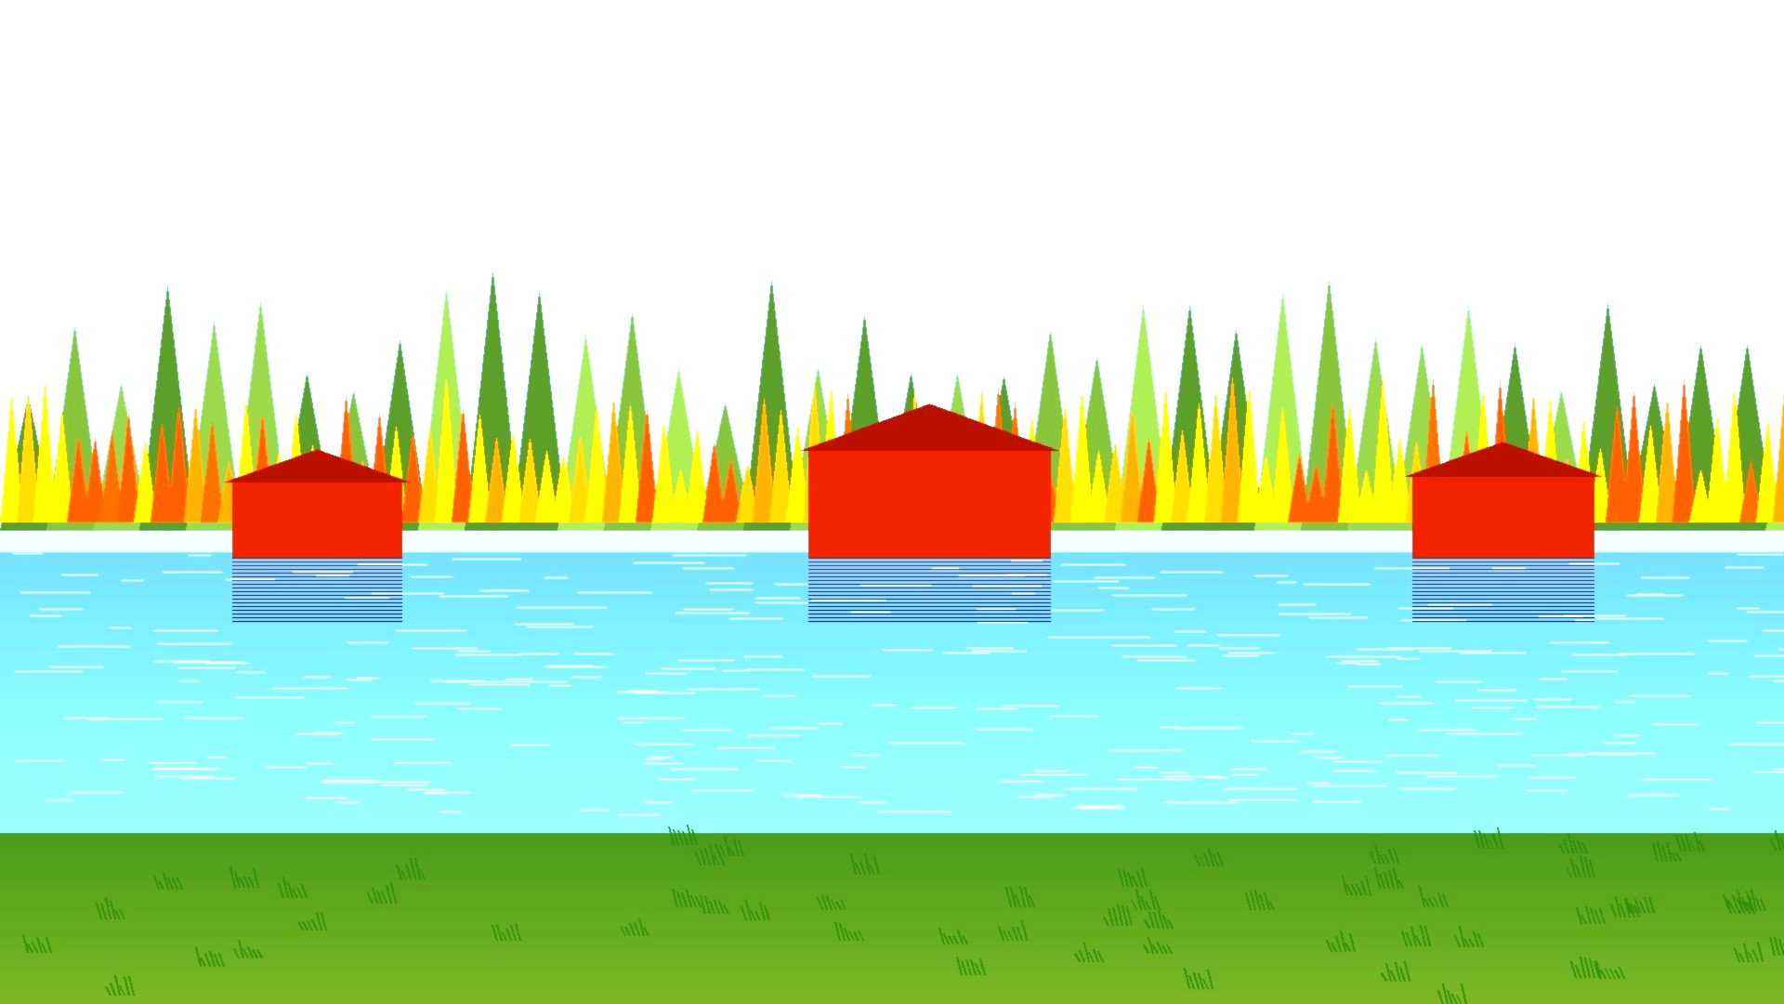
What were the first bridges constructed of?
How has bridge construction changed over time?

Slide 3
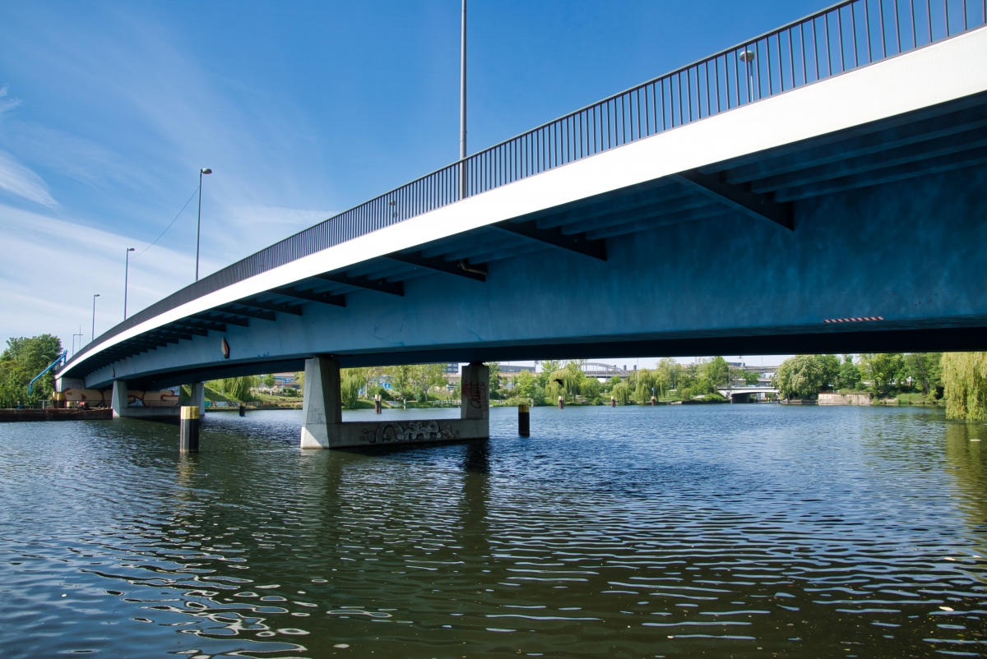
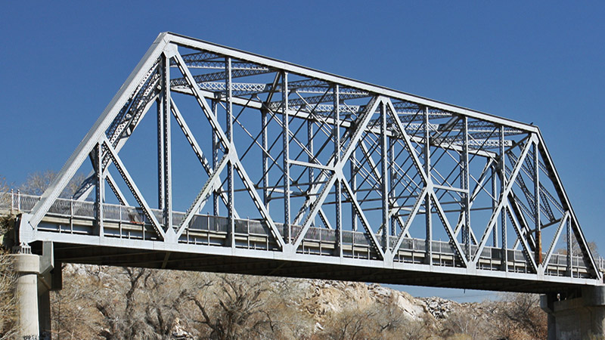
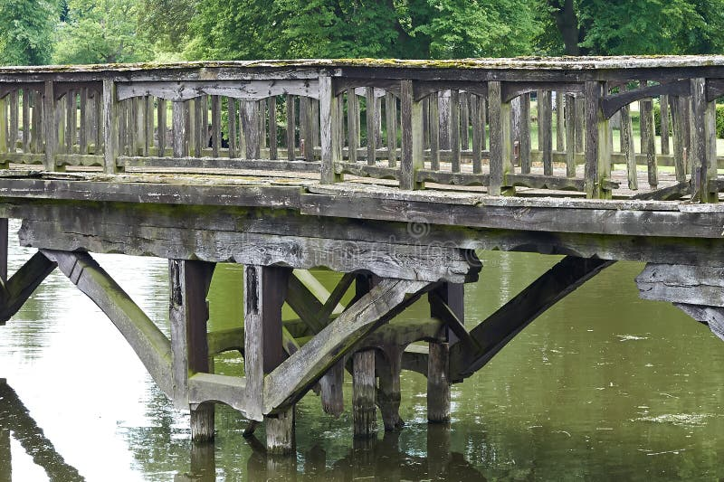
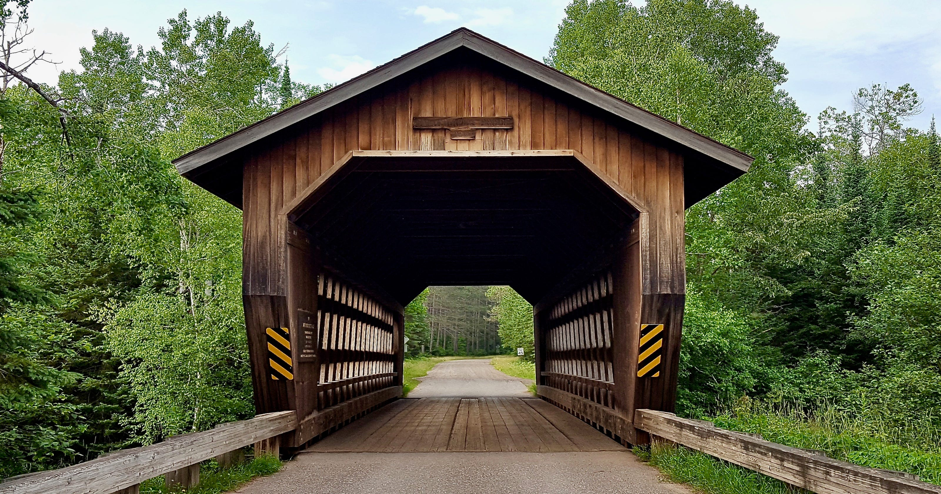
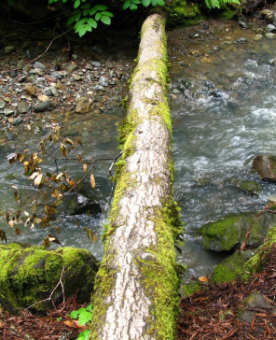
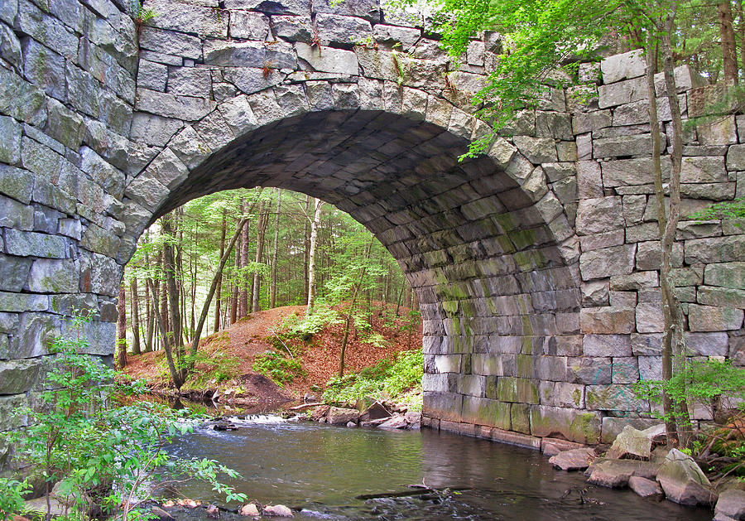
What is similar?
What is different?

Slide 4
Logs
One of the earliest bridges was a simple log bridge.
People placed strong, straight logs across streams to create a safe path.
Over time, they learned to choose thicker logs and position them carefully for better support and balance.
A log bridge is an early form of a beam bridge because the log carries weight across the gap to the supports at each end.

Slide 5
Wooden
As human history evolved, people developed the tools and knowledge to design more complex bridges.
Wooden bridges were some of the first created because trees were easy to cut, work with and they were a very abundant material.
Early wood bridges incorporated elements of arches, triangles and beams that are stilled used in more modern bridge construction.

Slide 6
Stone Arch
The arch was a revolution. Instead of bending, the arch redirects weight outward and downward into the ground.
Arch bridges use a curved shape called an arch. The arch helps spread weight into the supports on each side.
Stone bridges were stronger, more stable, and great for carrying heavy loads.

Slide 7
Steel Truss
As the industrial revolution began, steel became abundant.
Builders discovered that triangles spread weight evenly and help make bridges stronger.
Truss bridges use many triangles to span longer distances and carry heavier loads while using less material than wood or stone bridges.

Slide 8
Concrete Beam
A beam is a horizontal structure that spans between two supports called abutments.
The longer the beam, the more it bends in the middle so longer bridges need a pier in the middle of the river for extra support.
Concrete is the most common bridge material used today.
Wood, arch and truss bridges all may incorporate beams in the construction…as do covered bridges!

Slide 9
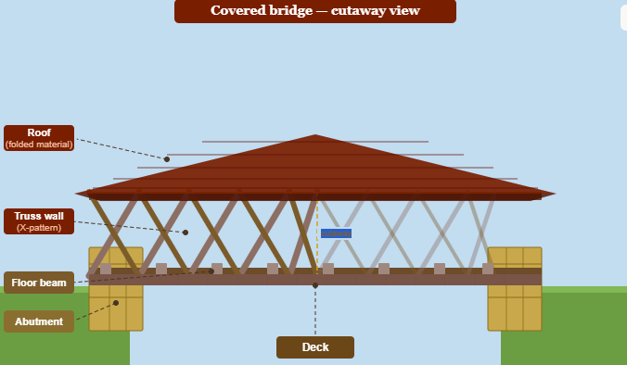
Covered Bridge
Covered bridges have a roof and walls built around and over the bridge structure.
The covering protects the wooden bridge from rain, snow, and ice, helping the wood and bridge last much longer.
Many covered bridges use strong wooden trusses inside for support and large wooden beams for supports.
Longer covered bridges would be built with multiple piers.

Slide 10
NB COVERED BRIDGE NUMBERS
400+
~58
391m
EVER
BUILT
STILL STANDING
WORLDS LONGEST

Slide 11
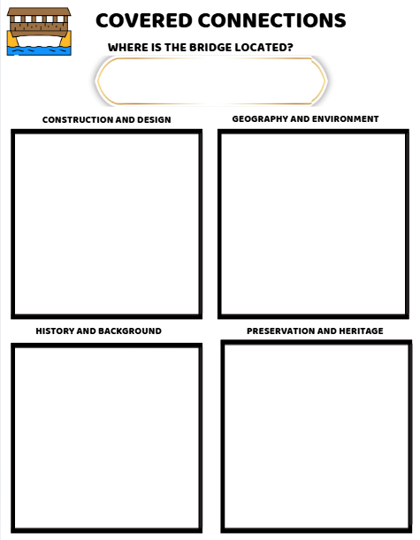
Phase 2 — Research
Construction & Design
→ What design features does you bridge have?
→ What materials were used?
→ When was it built?
→ How long is it?
Geography & Environment
→ Where is it located? What river or stream does it/did it cross?
→ What communities does it/did it connect?
→ What are the cultural/community benefits of the bridge?

Slide 12
Phase 2 — Research
History & Background
→ Is it still in use?
→ Has it been torn down?
→ What was the bridge used for?
→ Was it part of a trade or travel route?
Preservation & Heritage
→ Is it a designated heritage site?
→ What challenges or threats does it face today?
→ Should we protect these culturally/community significant bridges? Why or Why not?

Slide 13
Phase 3- Construction
1
Abutments
Choose the crossing point. Build stone abutments in the riverbanks to carry all load into the ground.
2
Truss Walls
Lay diagonal planks in two crossing directions. Drive wooden treenails at every intersection.
3
Deck & Beams
Connect the two trusses with floor beams. Lay running boards (deck) along the full length.
4
Roof
Steep roof sheds NB snow. Siding boards have gaps to let air dry the interior wood.

Slide 14
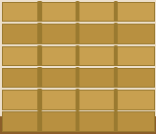
Step 1 of 4
Abutments
Build two strong abutments using popsicle sticks, folded cardboard, or other materials.
Place the abutments onto the cardboard base at each end of the bridge.
Glue them securely in place.
Tip
Make both the same height.

Slide 15
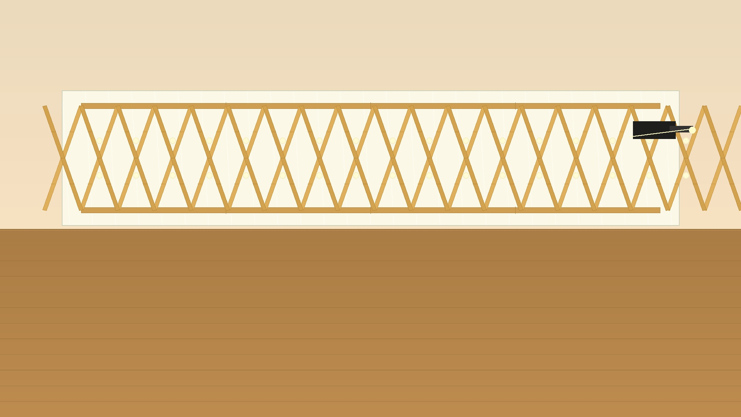
Step 2 of 4
Truss walls
The two X-pattern side frames.
Put wax paper on your desk. Lay sticks in two crossing directions to make the X-pattern. Glue every crossing point.
Make two — one for each side. Let dry flat.
Tip
Glue every crossing point — that is what makes it strong.

Slide 16

Step 3 of 4
Deck & Beams
Lay floor beams along the full length of the bridge.
truss wall
Then lay running boards (deck) across on top, from wall to wall. Pack them side by side to cover the whole floor.
Use popsicle sticks, cardboard strips, or other materials.
② deck boards
go across ↕
Tip
Glue the beams first and let them dry before adding the deck.
truss wall

Slide 17
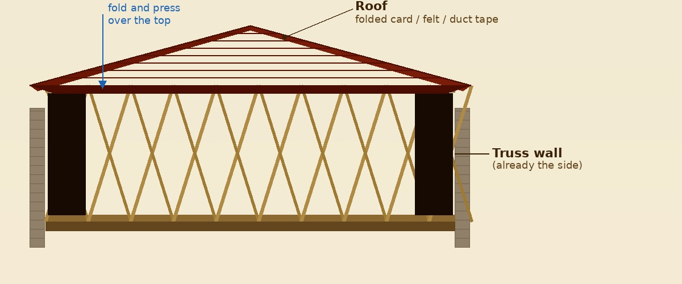
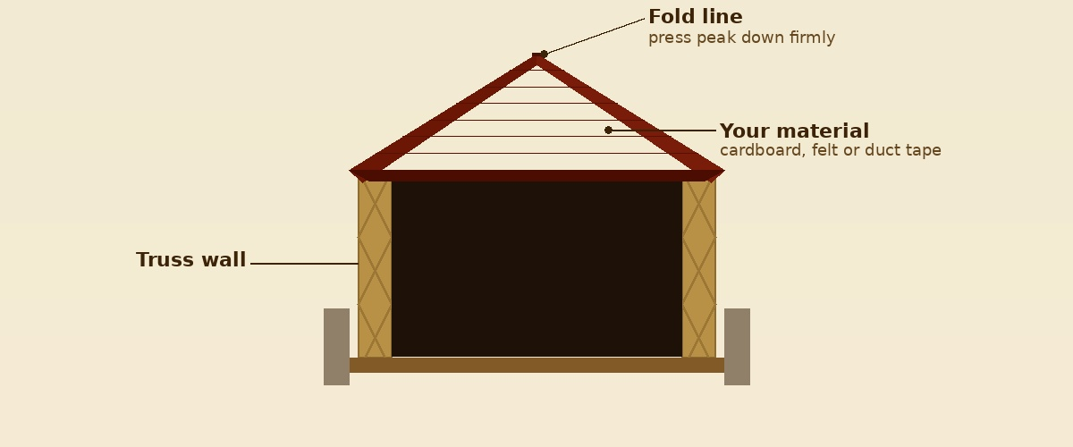
Side view
Step 4 of 4
Roof
Fold your material over the top of the bridge and glue it down to both truss walls.
Folded cardboard
Felt
End view
Duct tape
Sticks
Choose whatever material(s) work for you!

Slide 18
Phase 4 — Presentation and Showcase
Choose the format that suits how you communicate best:
PowerPoint or Canva presentation
Video Presentation or Digital Story
Podcast or audio recording
Poster or tri-fold board
Written research report
Blog post or class website
Your presentation should:
→ show research depth, creativity of construction, understanding of bridge concepts, and clarity of communication
→ address the four key domains; Construction & Design, Geography & Environment, History and Background, Preservation & Heritage

Slide 19
COVERED CONNECTIONS
MAKE MEANING

Slide 20
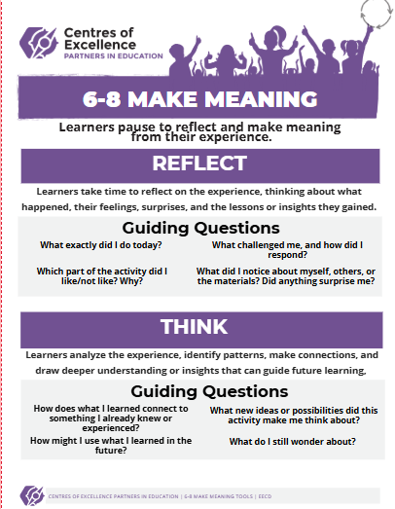

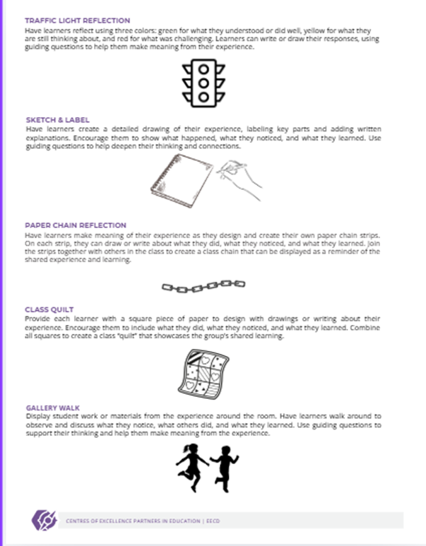

Slide 21
COVERED CONNECTIONS
EXTENSION IDEAS

Slide 22
HERITAGE FAIR
SHORT STORY
FIELD
TRIP

